Slide 1
How to Login
How to Join a Class
How to View Assignments
How to Submit & Unsubmit
How to Open Google Calendar
?
?
?
?
?

Slide 2
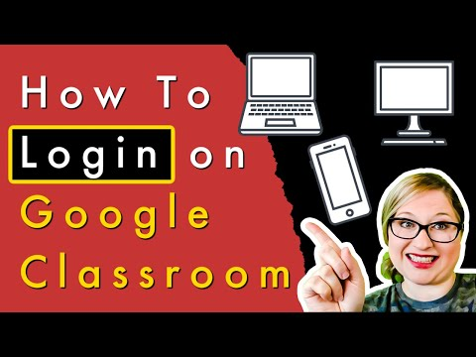
How to Login
How to Join a Class
How to View Assignments
How to Submit & Unsubmit
How to Open Google Calendar

Slide 3
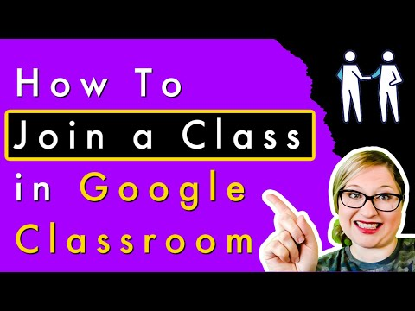
How to Login
How to Join a Class
How to View Assignments
How to Submit & Unsubmit
How to Open Google Calendar

Slide 4
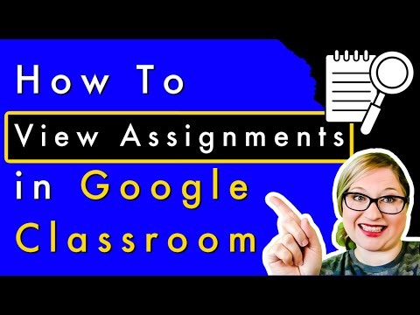
How to Login
How to Join a Class
How to View Assignments
How to Submit & Unsubmit
How to Open Google Calendar

Slide 5
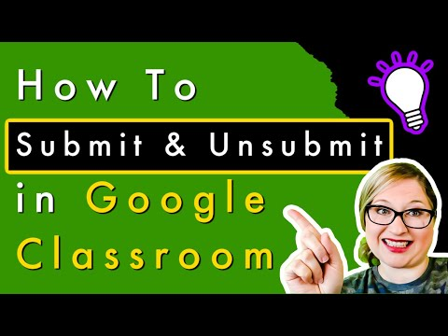
How to Login
How to Join a Class
How to View Assignments
How to Submit & Unsubmit
How to Open Google Calendar

Slide 6
How to Login
How to Join a Class
How to View Assignments
How to Submit & Unsubmit
How to Open Google Calendar
HERE

